Slide 1
Understanding the English Language Proficiency Assessments for California (ELPAC)

Slide 2
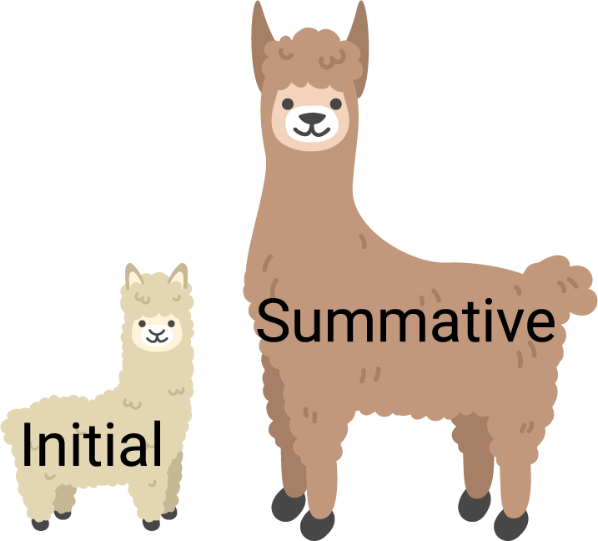
The ELPAC Has Two Assessments
Notes:
The first important thing to know is that the ELPAC is made up of two separate tests: the Initial ELPAC and the Summative ELPAC.
Each assessment has a different purpose.
The Initial ELPAC is used to identify a student as either an English learner who needs support to learn English, or as proficient in English.
The Summative ELPAC is used to measure the skills of English learners. The results will help tell the school or district if the student is ready to be reclassified as proficient in English.

Slide 3


Who:
Students in grades K through 12
Initial ELPAC
Summative ELPAC
Notes:
Let’s start by answering the question of who takes the ELPAC assessments.
For the Initial ELPAC, the test is given to students who are new to school in California AND whose Home Language Survey indicates a language other than English.
If your child is in their first year of school in California you completed a home language survey that asks what languages you speak at home when you enrolled your child in school.
When you said that your child speaks a language other than English at home, this tells us that we need to give your child the Initial ELPAC so we can learn about their English language proficiency.
The Initial ELPAC is given to students within 30 days of enrollment in a California school.
Students take the Initial ELPAC only once in their school career.
The Summative ELPAC is given to students who have been identified as English learners.
They will take this test each spring to measure their progress in learning English until they are reclassified as English proficient.

Slide 4
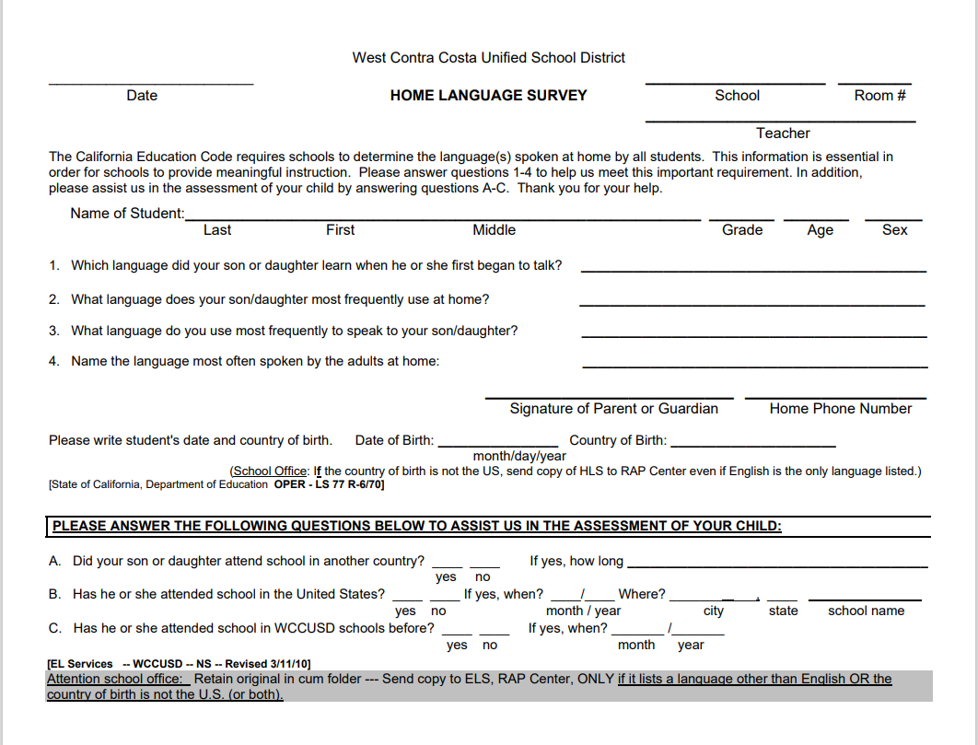
Home Language Survey

Slide 5

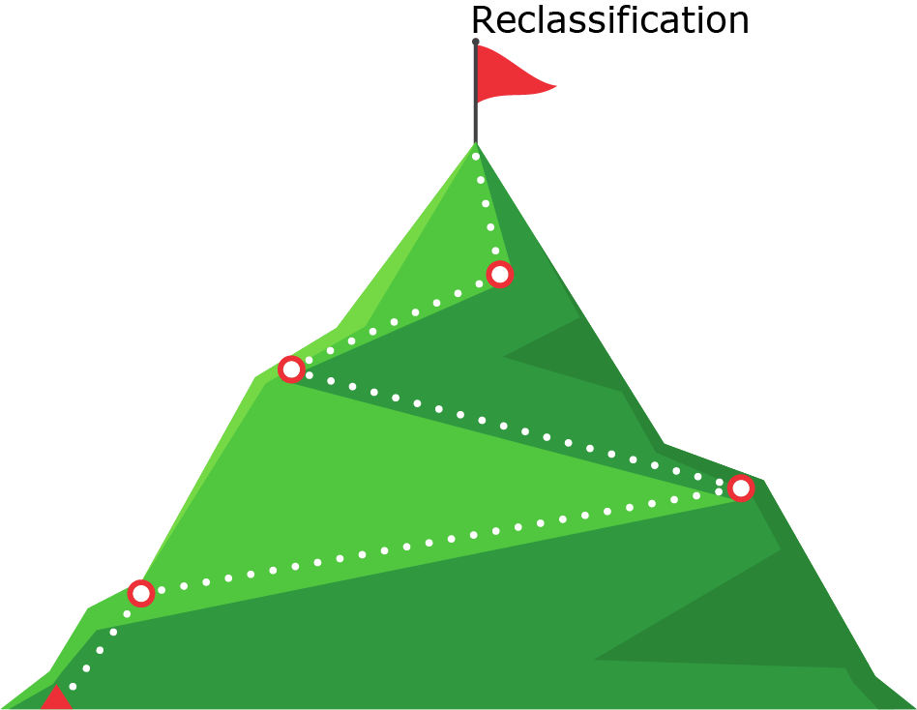
Why:
Initial ELPAC
Summative ELPAC
Notes:
You may be wondering why students need to take the ELPAC, other than the fact that it is a legal requirement.
The results of the Initial ELPAC are used to determine if your child needs support in learning English.
The Summative ELPAC is the test which will help the teachers gain a better understanding of what type and how much support students need so they can learn in English and be successful in school.
Additionally, and more importantly, it is this annual measure that tells us how much progress students are making in learning English and whether or not they are eligible for reclassification.

Slide 6


What:
WCCUSD RAP Center
TK – 2nd Grades
You will need to set up an appointment with the RAP Center! Please make sure your PowerSchool Information is current!
If you need help updating your PowerSchool information, please call Ms. Ana B. at Dover. 510-231-1420
RAP Center Testing Schedule for grades TK – 2nd :
*To Be Announced*
Notes:
So far, we have talked about why the ELPAC is given and to which students, but what is it?
The ELPAC is the test that is used to measure how well California students understand English.
This test will give you and your child’s teacher information about your child's progress in learning in English, and how to best support your child at home and at school towards English language proficiency.
When your child takes the ELPAC, they will be tested in four different areas:
Reading
Writing
Listening, and
Speaking

Slide 7
What:
WCCUSD RAP Center
3rd – 6th Grades
Dover School
You will need to set up an appointment with the RAP Center for the Speaking Section assessment!
Please make sure your PowerSchool Information is current!
If you need help updating your PowerSchool information, please call Ms. Ana B. at Dover. 510-231-1420
Here is a tentative schedule for RAP Center administration of the ELPAC Speaking Section for Grades 3-6:
March 15-16 grade 6
March 17-18 grade 5
March 19-23 grade 4
March 24-26 grade 3
Notes:
So far, we have talked about why the ELPAC is given and to which students, but what is it?
The ELPAC is the test that is used to measure how well California students understand English.
This test will give you and your child’s teacher information about your child's progress in learning in English, and how to best support your child at home and at school towards English language proficiency.
When your child takes the ELPAC, they will be tested in four different areas:
Reading
Writing
Listening, and
Speaking

Slide 8
Dover ELPAC Testing Schedule – Spring 2021
3rd - 6th and RSP
ELPAC Week 1: March 22 – March 26
 | Monday | Tuesday | Wednesday | Thursday | Friday
10:00 – 10:15 am | Morning Meeting | Morning Meeting | Morning Meeting | Morning Meeting | Morning Meeting
10:15 am – 12 pm | Group A ELPAC Day 1-Listening | Group A ELPAC Day 2-Reading | Group A ELPAC Day 3-Writing1 | Group A ELPAC Day 4-Writing2 | Meeting Day
1 pm – 3 pm | Regular instruction | Regular instruction | Regular instruction | Regular instruction
ELPAC Week 1 with RSP teachers: March 22 – March 26
 | Monday | Tuesday | Wednesday | Thursday | Friday
10:00 – 10:15 am | Morning Meeting | Morning Meeting | Morning Meeting | Morning Meeting | Morning Meeting
10:15 am – 12 pm | RSP Group A ELPAC Day 1-Listening | RSP Group A ELPAC Day 2-Reading | RSP Group A ELPAC Day 3-Writing1 | RSP Group A ELPAC Day 4-Writing2 | Meeting Day
1 pm – 3 pm | Regular instruction | Regular instruction | Regular instruction | Regular instruction

Slide 9
ELPAC Week 2: March 29 - April 2
 | Monday | Tuesday | Wednesday | Thursday | Friday
10:00 – 10:15 am | Morning Meeting | Morning Meeting | Morning Meeting | Morning Meeting | Morning Meeting
10:15 am – 12 pm | Group B ELPAC Day 1-Listening | Group B ELPAC Day 2-Reading | Group B ELPAC Day 3-Writing1 | Group B ELPAC Day 4-Writing2 | Meeting Day
1 pm – 3 pm | Regular instruction | Regular instruction | Regular instruction | Regular instruction
ELPAC Weeks 2 with RSP teachers: March 29 – April
 | Monday | Tuesday | Wednesday | Thursday | Friday
10:00 – 10:15 am | Morning Meeting | Morning Meeting | Morning Meeting | Morning Meeting | Morning Meeting
10:15 am – 12 pm | RSP Group B ELPAC Day 1-Listening | RSP Group B ELPAC Day 2-Reading | RSP Group B ELPAC Day 3-Writing1 | RSP Group B ELPAC Day 4-Writing2 | Meeting Day
1 pm – 3 pm | Regular instruction | Regular instruction | Regular instruction | Regular instruction

Slide 10

How:
Computer–Based
By a Test Examiner
In groups or individually
Notes:
How is the ELPAC given to students?
The ELPAC is transitioning from a paper-pencil test to a computer based test.
They are given by a trained test examiner.
For our youngest students in Kindergarten through 2nd grade, the test is given individually.
Grade two Listening and Reading will be computer-based and administered one-on-one. However, the Writing domain in grade two will continue to be paper-based and delivered in small groups.
For students in grade three and above, the Listening, Reading, and Writing section is administered in a group. The Speaking section is always done individually.

Slide 11
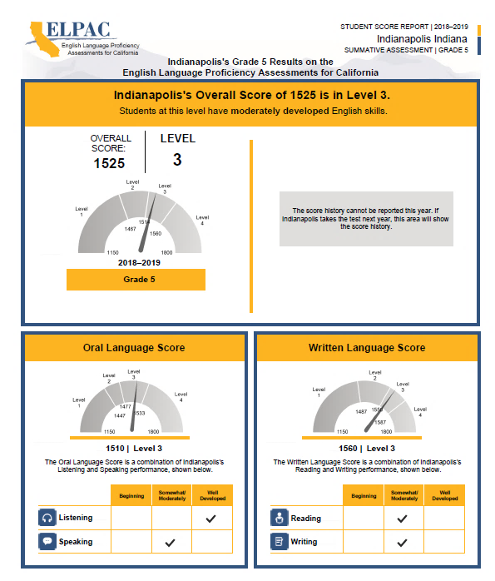
Scores:
Notes:
[BEFORE PRESENTING, SELECT THE SCORE REPORT IMAGE ON THIS SLIDE. GO TO THE “FORMAT” TAB ON THE TOP TOOLBAR. SELECT THE “RESET PICTURE” BUTTON TO REMOVE THE BLUR EFFECT AND REVEAL THE DETAILED REPORT.]
Your child will receive a Score Report that looks like this one for the Summative ELPAC.
Students who take the ELPAC will receive scores in the summer or fall.
[Insert more specific information about the timing of this report for your school]
It will have their overall score which is a four-digit number.
The overall level will be 1, 2, 3, or 4, where 4 is the highest level and means that the student has a good understanding of English.
Your child will also receive level scores for Oral Language that includes Listening and Speaking and Written Language that includes Reading and Writing. The level score will be one of the following:
Beginning
Somewhat/Moderately, or
Well Developed

Slide 12

Help Your Child Succeed
Provide a quiet place for your child to take the ELPAC.
Read with your child.
Ask your child to tell you what he or she sees in the picture or what is happening in the picture.
Provide your child with opportunities to use language.
Notes:
Additionally, here are a few other ways that you can help your child be successful:
[For elementary schools]
Encourage your child to read daily.
[For middle and high schools]
Your child will likely have homework every day. You can help support their success by making sure your child has a quiet place at home to do that work that is free from distractions.
[For all students]
When it’s time for testing, talk to your child about the test. Make sure your child knows that the tests are important, but they are just one measure of learning. The teacher uses that information along with other information to make sure your child is getting the support they need.
If you’re interested, the California Department of Education has also developed ELPAC Practice Tests that you can access from home on the computer. You can look at sample test questions and get familiar with the way questions are presented on the computer. More information about the ELPAC Practice Tests are on the Parent Resources flyer that you received today/tonight.

Slide 13

Videos for Parents/Families
ELPAC Overview
Understand more about the ELPAC!
Overview video of the computer-based ELPAC Assessment for parents
Spanish version
Overview video of the computer-based ELPAC Assessment for parents
English version

Slide 14
LET’S PRACTICE!
How To Take a Remote Test like the ELPAC
Introductory Link to Video for Students (and Families)

Slide 15
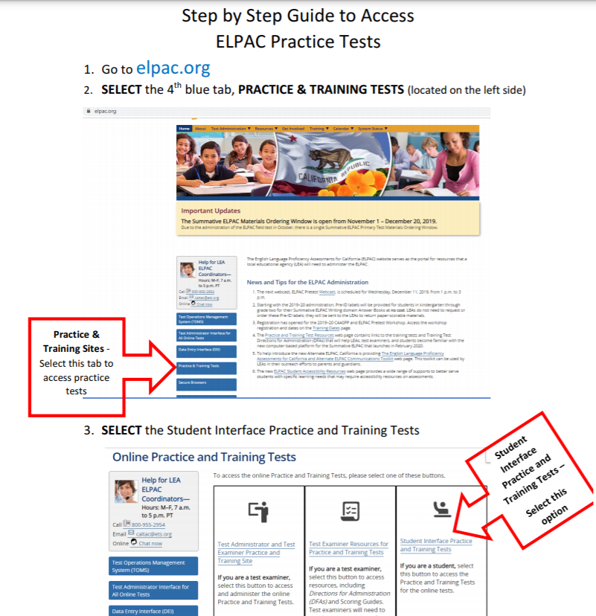
Get an idea of what your child will be asked to speak, listen to, read, and write in English on the ELPAC.
Take a Practice Test with your child!
Have your child practice using the Practice Test!

Slide 16


Or…
Use this link to go straight to the Student Practice Test “Guest Sign In” page.
Practice and Training Test link

Slide 17
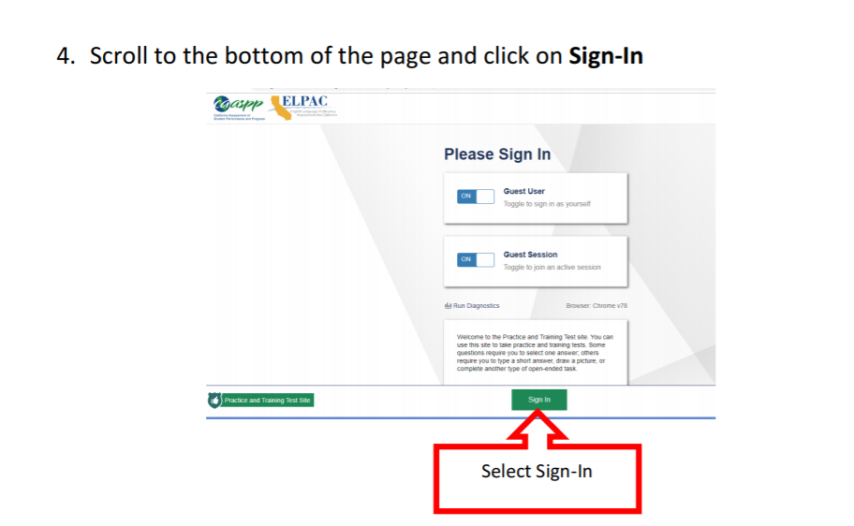

Slide 18
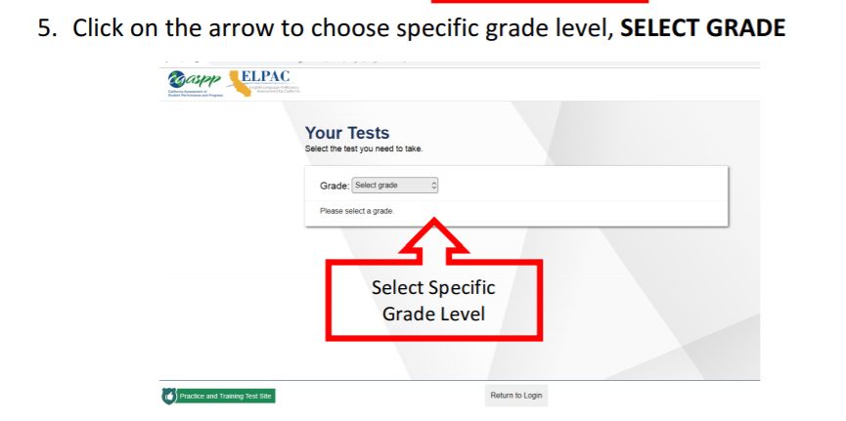

Slide 19
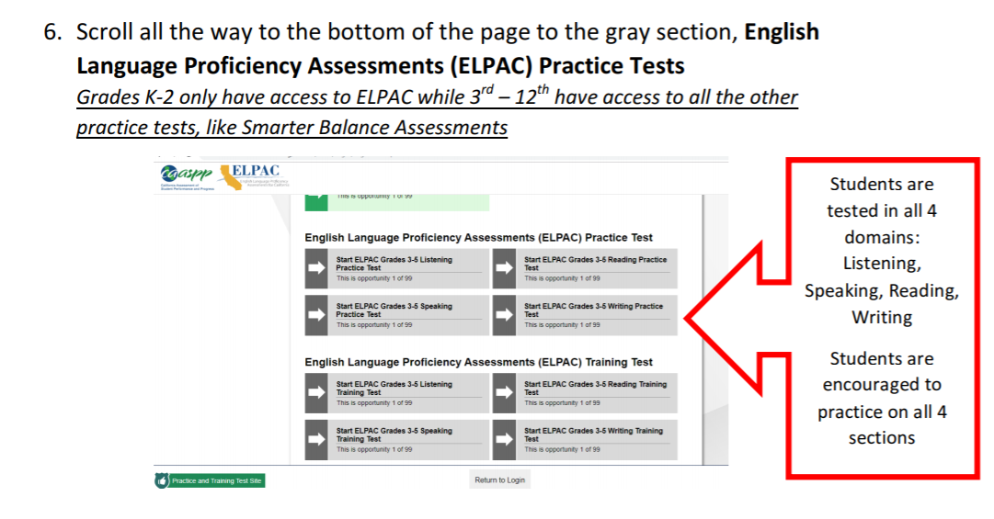

Slide 20
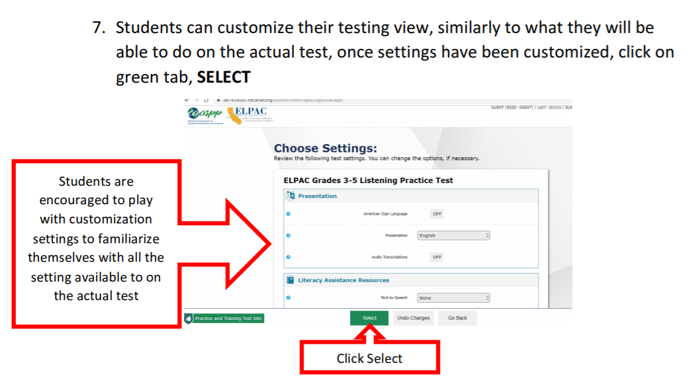

Slide 21
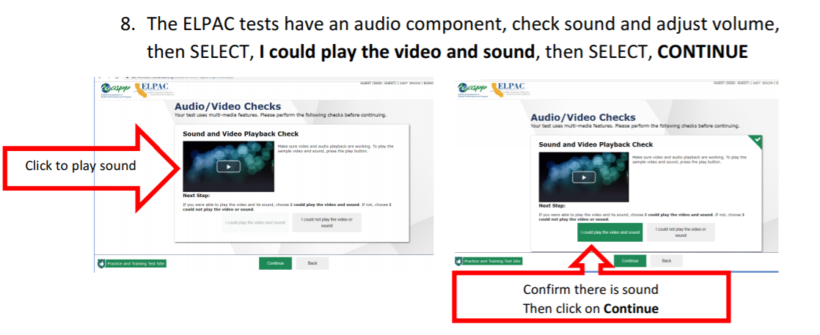

Slide 22
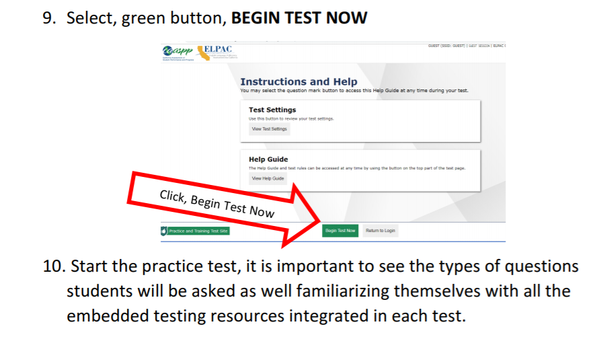

Slide 23
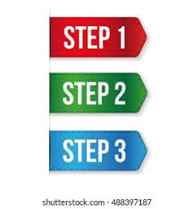
Next!
Step-by-step instructions
for students
signing into the ELPAC
Summative Assessment

Slide 24
ELPAC Summative Testing Instructions
*Thanks to Nicholas Ray & Staff at El Cerrito HS for sharing these instructions with us!*

Slide 25
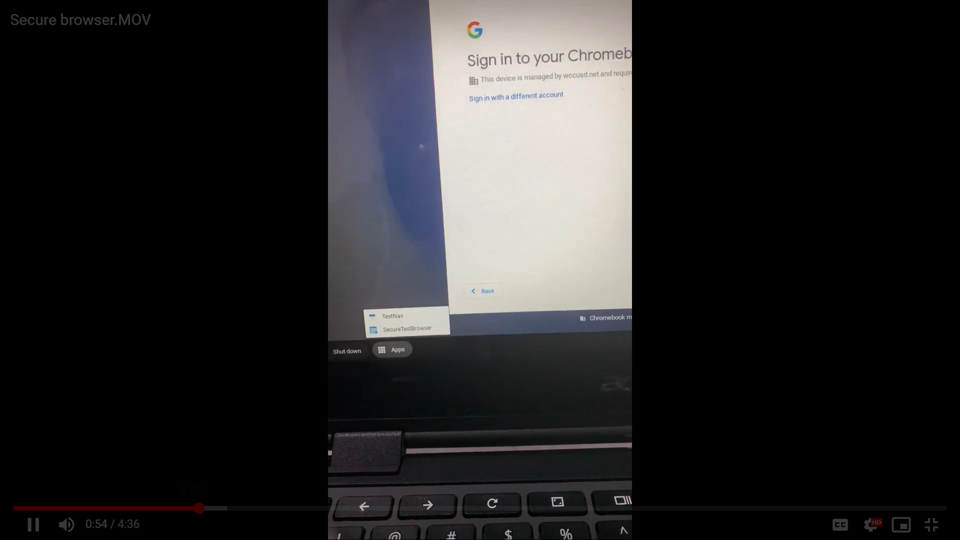
Use a district computer
Do NOT sign in
On the log-in screen
Click on the Apps button

Slide 26
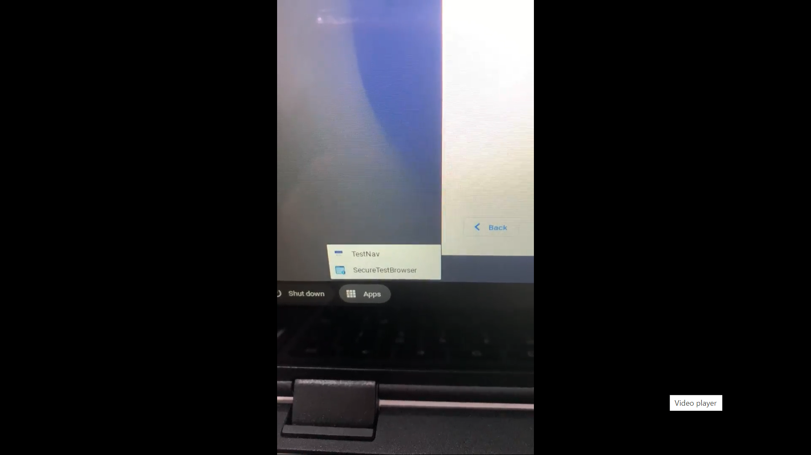
Click on Secure Test Browser

Slide 27
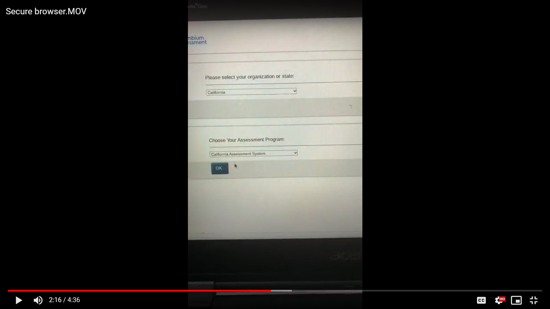
Select California
Select California Assessment System

Slide 28
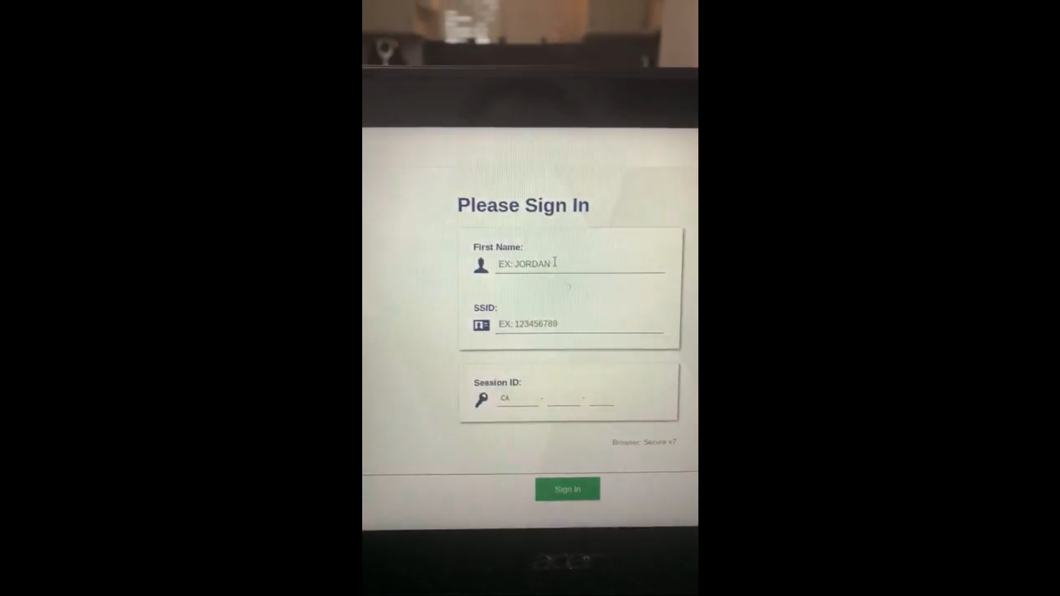
Type your legal first name
Enter your SSID# (in your email)
Enter the Session ID

Slide 29
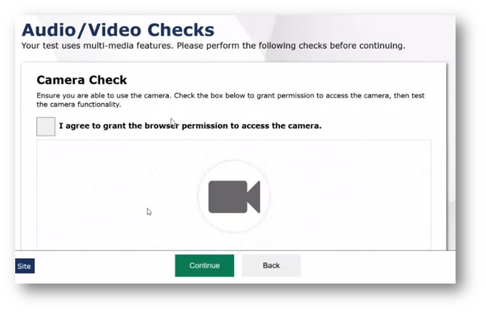
Student Audio/Video Checks
Click “I agree” to turn the camera on - YOU MUST DO THIS TO TAKE THE TEST
Notes:
•Most of you are familiar with the audio and video checks that students are presented with at the beginning of a test.
•Those checks are similar to what they would normally see, except the students are now prompted with a Camera Check window.
•In a remote test session, students will need to select the box to agree to grant the browser permission to access their camera.

Slide 30
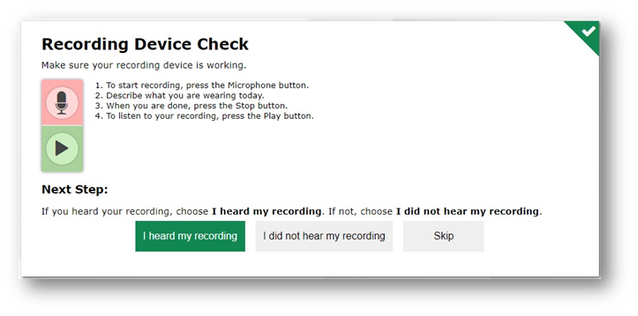
Recording Device Check
Click “I heard my recording” to turn the camera on - YOU MUST DO THIS TO TAKE THE TEST
Notes:
•The Recording Device Check screen will be a new check for most students, unless they have taken an ELPAC speaking assessment.
•The student will select the [Microphone] icon button, record a brief statement, press the [Stop] icon button, and then replay the recording.
•The student will then select whether the student heard the recording or wants to skip the check.
•This check is now required for all students in case they enter into a call with their test administrator or test examiner during a remote test session.

Slide 31
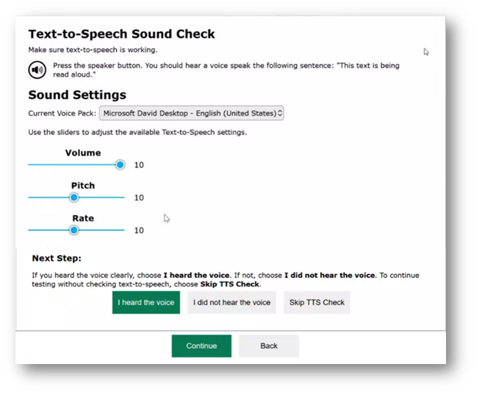
Text-to-Speech Sound Check
All students are prompted with the text-to-speech sound check, whether or not text-to-speech is an assigned test setting
Notes:
•The other new check that students will be prompted with is the Text-to-Speech Sound Check screen.
•All students will get this check, regardless of whether or not they have text-to-speech as an assigned test setting because in a remote test session, any messages from the test administrator or test examiner can be played audibly on the student’s device.
•The student will select the [Speaker] icon button, have the opportunity to change the voice pack, and adjust the volume, pitch, or rate. The student will then indicate whether the student heard the voice, did not hear the voice, or wants to skip the check, and then select continue.

Slide 32
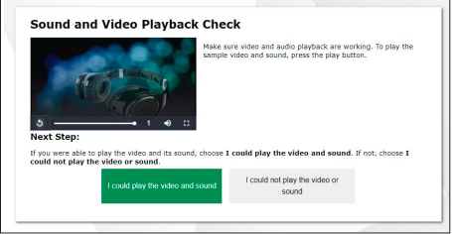
Sound and Video Check
Play the sound/video
If you cannot hear, make sure your volume is turned up
Select “I could play the video and sound”
Notes:
•The other new check that students will be prompted with is the Text-to-Speech Sound Check screen.
•All students will get this check, regardless of whether or not they have text-to-speech as an assigned test setting because in a remote test session, any messages from the test administrator or test examiner can be played audibly on the student’s device.
•The student will select the [Speaker] icon button, have the opportunity to change the voice pack, and adjust the volume, pitch, or rate. The student will then indicate whether the student heard the voice, did not hear the voice, or wants to skip the check, and then select continue.

Slide 33
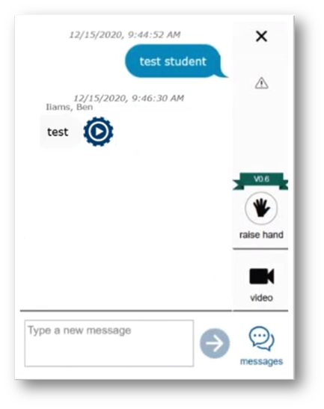
Requesting Help
Click Raise hand button
View video feed to connect with the teacher
Send messages to the teacher giving the test
You cannot work on the test while communicating with the teacher
Notes:
•In the test delivery system, the student does not have the option to turn off their video or audio like the test administrator or test examiner does.
•The student can select the [raise hand] icon to indicate to the test administrator or test examiner the need for assistance. We will show what that looks like on the Test Administrator Interface side in just a moment.
•The student can select the [video] icon to view the student’s own video feed.
•The student can select the [messages] icon to send a message to the test administrator or test examiner. Messages appear in the communication window similar to how they would appear in a text message conversation on a cell phone.
•When the test administrator or test examiner responds to the student, the message will have a play button next to it, allowing the student to play the message.
•The student cannot interact with the test content while the communication widget is open.

Slide 34
Listening Section
You will be on camera, so no phones. :)
If you need help, please use the ‘request help’ button within the test.
You will listen to a recording and then answer some questions about it after listening.
You must mark or write something for each question before moving to the next question!
  If you are unsure, choose the answer you think is best and flag the question for review.
  You can go back and change it later if you like.
When you are finished with the test, let your teacher know. She or he will remind you know how to check your work before submitting the test.

Slide 35
Listening Section
Estarás frente a la cámara, así que no hay teléfonos. :)
Si necesita ayuda, utilice el botón "solicitar ayuda" dentro de la prueba.
Escucharás una grabación y luego responderás algunas preguntas al respecto después de escucharla.
¡Debes escribir algo para cada pregunta antes de pasar a la siguiente!
  Si no estás seguro/a/x, escriba la respuesta que crea que es mejor y marque la pregunta para su revisión.
  Puede volver atrás y cambiarlo más tarde si lo desea.
Cuando haya terminado con la prueba, notificará su maestro/a/x quien va a recordarles como revisaran sus respuestas antes de enviar el examen.

Slide 36
Reading Section
You will be on camera, so no phones. :)
If you need help, please use the ‘request help’ button within the test.
You will first read a short selection and then answer some questions or write about what you read.
You will have the time you need to read, think, and then choose your response.
If you are unsure, choose or write the answer you think is best and flag the question for review.
You may go back and change your answers at anytime in the test.
When you are finished with the test, let your teacher know. She or he will let you know how to check your work before submitting the test.

Slide 37
Reading Section
Estarás frente a la cámara, así que no hay teléfonos. :)
Si necesita ayuda, utilice el botón "solicitar ayuda" dentro de la prueba.
Primero leerá una breve selección y luego responderá algunas preguntas o escribirá sobre lo que leyó.
¡Debes responder algo para cada pregunta antes de pasar a la siguiente!
  Si no está seguro, escriba la respuesta que crea que es mejor y marque la pregunta para su revisión.
  Puede volver atrás y cambiarlo más tarde si lo desea.
Cuando haya terminado con la prueba, notificará su maestro/a/x quien va a recordarles como revisaran sus respuestas antes de enviar el examen.

Slide 38
Writing Section
You will be on camera, so no phones. :)
If you need help, please use the ‘request help’ button within the test.
You will hear or read some questions, and then answer them by typing your response to the questions.
You will have the time you need to write a complete response.
- Try to answer the best you can on every question completely!
If you are unsure, write the answer you think is best and flag the question for review.
You may go back and change your answers at anytime in the test.
When you are finished with the test, let your teacher know. She or he will let you know how to check your work before submitting the test.

Slide 39
Writing Section
Estarás frente a la cámara, así que no hay teléfonos. :)
Si necesita ayuda, utilice el botón "solicitar ayuda" dentro de la prueba.
Primero leerá o escuchará una breve selección y luego responderá algunas preguntas o escribirá sobre lo que leyó.
Tendrá cualquier tiempo que necesitará para escribir respuestas totalmente completas.
  Si no está seguro, escriba la respuesta que crea que es mejor y marque la pregunta para su revisión.
  Puede volver atrás y cambiarlo más tarde si lo desea.
Cuando haya terminado con la prueba, notificará su maestro/a/x quien va a recordarles como revisaran sus respuestas antes de enviar el examen.

Slide 40
FAQ
Q: I need help during the test but I can’t use my phone! What do I do?
A: Use the ‘raise hand’ feature IN the test. You can type with us or talk with us via video :)
Q: Where can I find my SSID number?
A: First, make sure you write it in a safe place where you won’t lose it and others won’t see it.
Second, you can ask your teacher.
Q: I got logged off!
A: That is ok - just log back in! You will start from where you left off.
Q: I lost my internet!! What do I do?
A: Try to reconnect. You can be away from your test for 20 minutes.

Slide 41
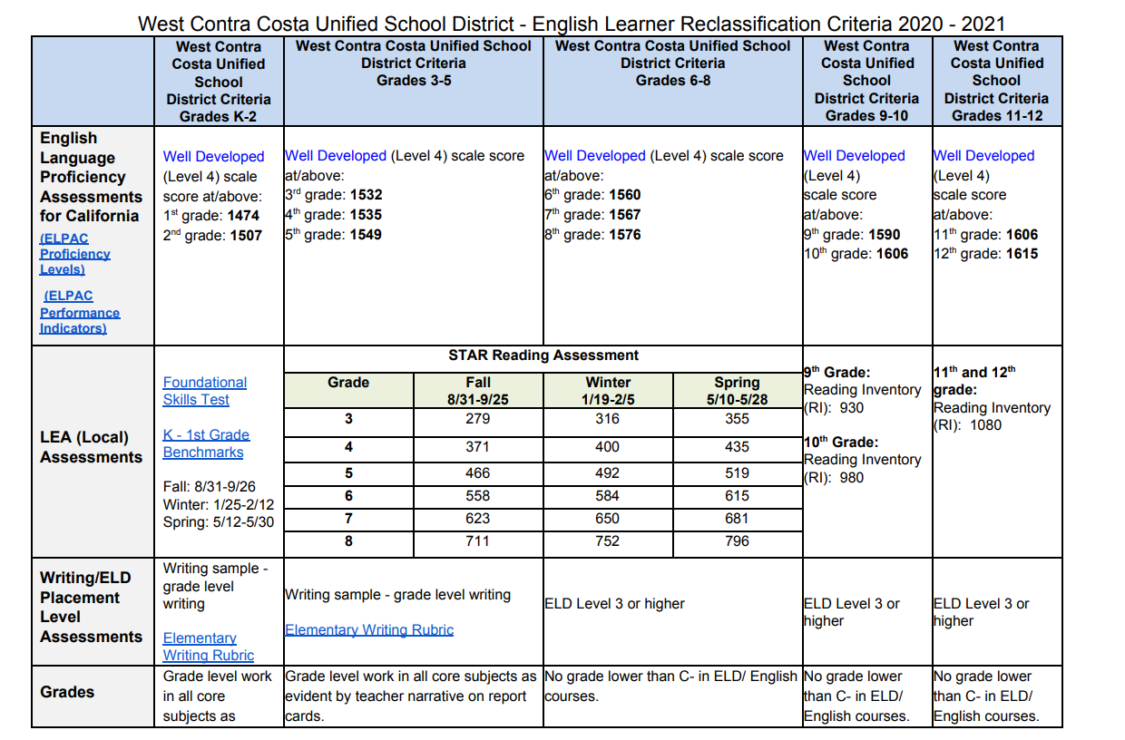
Reclassification
Criteria based upon a student’s ELPAC score…

Slide 42
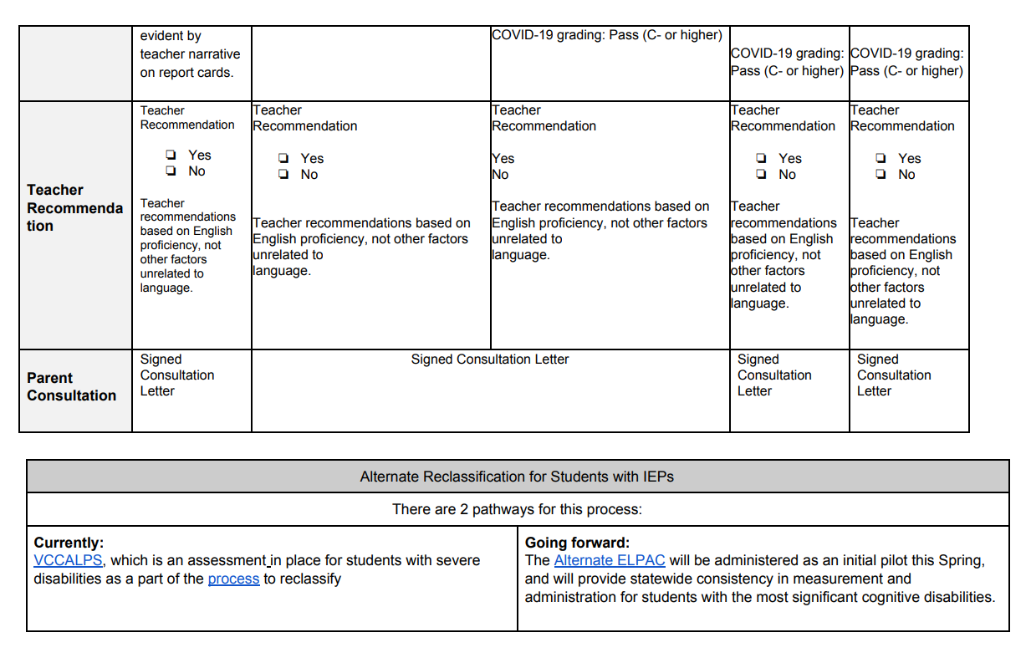
Reclassification
Criteria
Continued…

Slide 43
Learn More:
Take an ELPAC Practice Test with your child at home
  http://www.elpac.org/resources/practicetests/
Starting Smarter
  https://elpac.startingsmarter.org
Notes:
There are practice tests available that will help you and your child understand the type of test questions that they might receive. You can take the practice tests from home with your child.

Slide 44
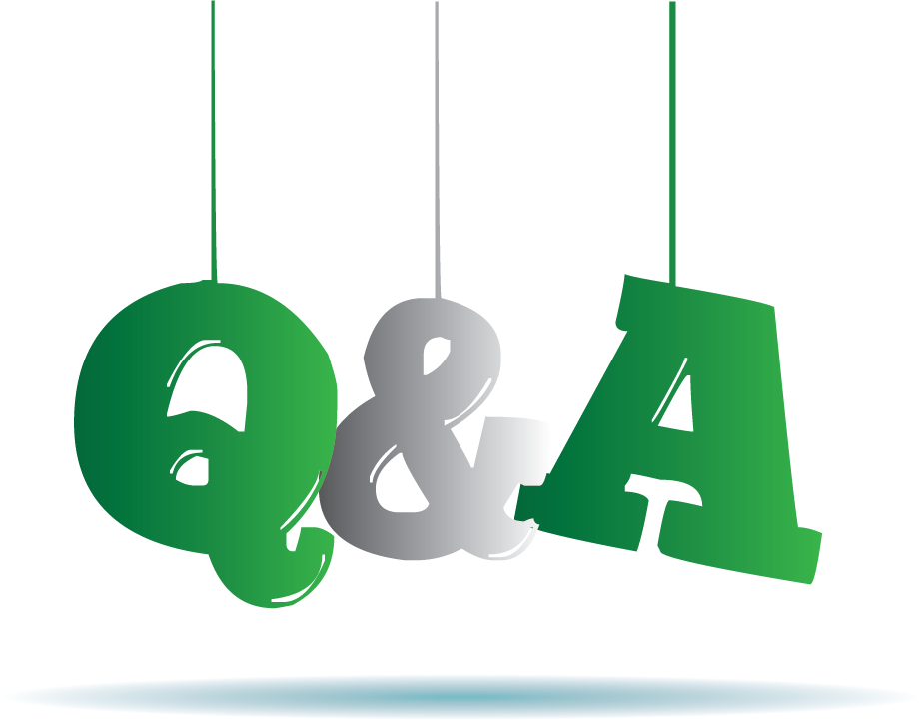
Questions
Notes:
That brings us to the end of today/tonight’s presentation.
We’ll take a moment to answer some of your questions now.
Thank you for coming today/tonight!

